Slide 1

IT TICKET ANALYSIS
Optimizing IT Support Through Data Insights
- Guria Gupta

Slide 2

IT SUPPORT TICKET MANAGEMENT
1. Overview: This dashboard presents an analysis of IT ticket data from 2016 to 2020.
2. Key Metrics Tracked: It highlights trends in ticket volume, agent performance, and resolution times.
3. Ticket Volume: A total of 97,498 tickets were handled by 50 IT agents.
4. Resolution Insights: The average resolution time is 4.5 days, with hardware being the top issue category.
5. Issue Breakdown: Most tickets had a “Normal” severity level and 75% were IT requests.
6. Objective: The goal is to identify key insights to improve IT support efficiency.

Slide 3

problem statements
High Ticket Volume vs. Limited Staff 97,498 tickets handled by only 50 agents may lead to overloading and burnout.
Long Resolution Time An average resolution time of 4.5 days, with peaks at 7.6 days, suggests delays in issue handling.
Mismatch Between Severity and Priority Although 91% of tickets are marked "Normal," 37% are tagged as "High" priority — indicating possible misalignment.
Dominance of Hardware Issues Hardware makes up 39% of all tickets, signaling a need to improve hardware reliability or support processes.
Underutilized Categories Login Access issues only represent 2%, but take the least time to resolve — may need reassessment of ticket routing.
Satisfaction Still Has Room to Improve Satisfaction scores have improved but remain just above 4.0 — not exceptional for support standards.
Heavy Skew Toward IT Requests 75% of tickets are requests, suggesting inefficiencies in proactive IT services or user enablement.

Slide 4

Workflow
Data Collection
Data Cleaning & Preparation
Exploratory Data Analysis (EDA)
Data Visualization
Insight Generation
Conclusion & Recommendations

Slide 5

Let’s get into
Business Problems

Slide 6

CHARTS AND INSIGHTS
Satisfaction Rate Vs Years
Resolution Time Over Years
Ticket Count Vs Years
Distribution as per Satisfaction Rate
Distribution as per Resolution Days
Age Group Vs Satisfaction Rate & Resolution Time
Resolution Time By Resolution Category
Categorical Charts-
Severity, Request Category, Priority
Slicers -
Years, Severity, Priority and Request Category.

Slide 7
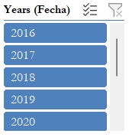
1. Ticket volume over years
Insights:
Consistent Growth: Ticket count increased steadily from 13,051 in 2016 to 29,088 in 2020.
Highest Growth: The largest jump occurred between 2019 and 2020, with an increase of 7,598 tickets (about 35%).
Overall Increase: Total ticket count more than doubled over the 5-year period.
Implication: This trend may indicate increased service usage, growing customer base, or rising support needs.

Slide 8
2. Satisfaction rate vs years
Insights:
Satisfaction Rate Insights (2016–2020)Satisfaction rates increased steadily from 3.98 in 2016 to 4.16 in 2020.
2020 had the highest rate (4.16), showing peak user satisfaction.
The biggest jump was from 2016 to 2017 (+0.09).
Growth remained consistent and positive each year, reflecting ongoing improvements.

Slide 9
3. Average Resolution time OVER YEARS
Insights:
Resolution time slightly increased from 4.55 in 2016 to 4.59 in 2020.
2020 had the longest resolution time (4.59).
Fluctuations were minor, showing a generally stable trend.
The lowest point was in 2019 (4.52) before rising again.

Slide 10
4. TICKETS BY CATEGORY
Insights:
Hardware issues are the most common (39% of tickets).
System-related tickets are the second highest (33%).
Software issues make up 26%.
Login access problems are minimal (only 2%).

Slide 11
5. REQUEST CATEGORY BY RESOLUTION TIME
Insights:
Hardware (7.63):Strong understanding and handling of physical components — a clear strength.
Login Access (0.31):Very weak; likely lacks knowledge of authentication, credential management, or security protocols.
Software (5.24):Moderate proficiency; some familiarity with tools, but there's room for improvement.
System (6.62):Good grasp of operating systems and system-level operations.

Slide 12
6. SATISFACTION RATE BY AGE GROUP
The age group 45-49 has the highest average satisfaction rate (4.30).
The age group 35-39 has the lowest average satisfaction rate (3.93).
Insights:

Slide 13
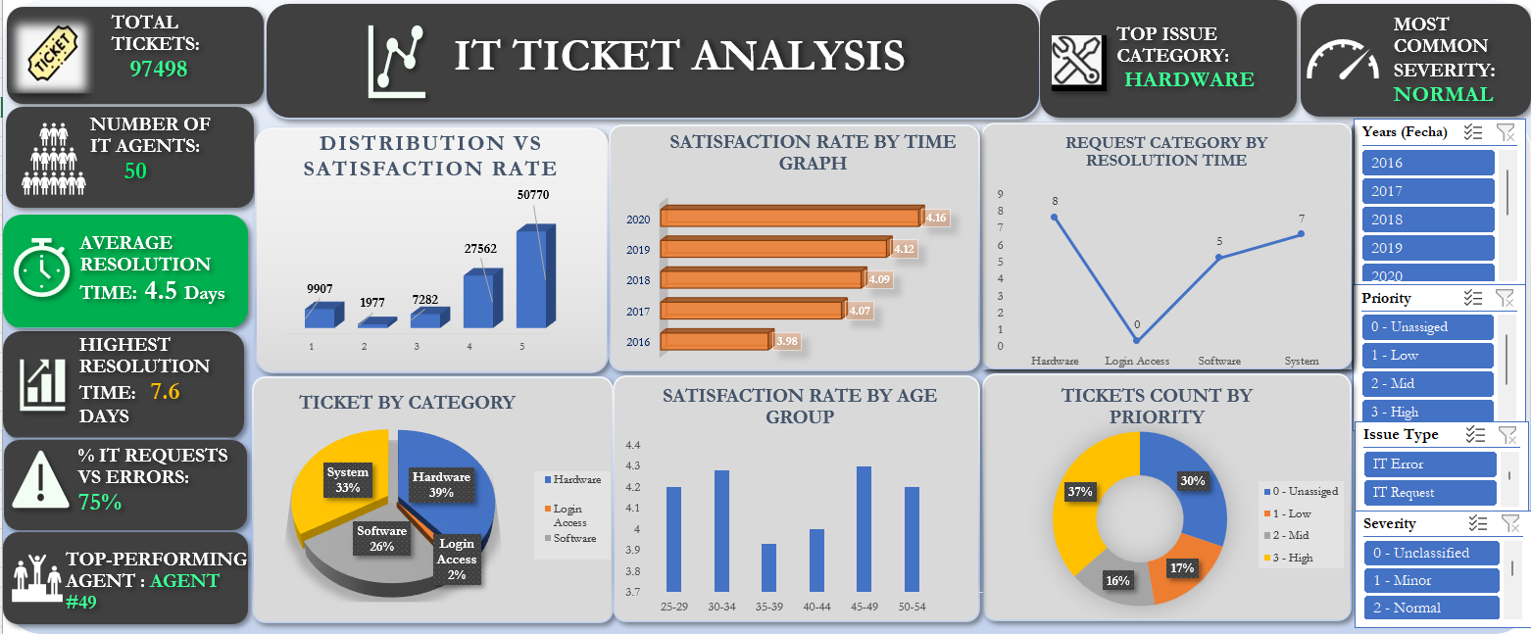
DASHBOARD AND VISUALIZATION

Slide 14
recommendations
Optimize Agent Workload Consider hiring or redistributing tasks—50 agents for nearly 97,498 tickets suggests potential overload.
Reduce Resolution Time Target process automation or AI-based ticket routing to bring down the average resolution from 4.5 days.
Align Severity with Priority Implement stricter ticket triage rules to reduce mismatches between severity (91% Normal) and priority (37% High).
Address Hardware Issues Proactively Since 39% of tickets are hardware-related, investigate root causes and explore preventive maintenance.
Enhance Training Programs Train agents, especially newer ones, to improve efficiency and maintain consistent satisfaction scores.
Improve Satisfaction Further Aim to push the satisfaction score above 4.5 by enhancing communication and first-contact resolution.
Leverage Top Performers Use insights from top agents (e.g., Agent #49) to mentor or train others for performance improvement.
Monitor Ticket Backlogs Add a backlog trend metric to identify bottlenecks and adjust resource allocation dynamically.

Slide 15
Top Key Insights
High Ticket Volume in Specific Categories
A significant percentage of tickets fall under recurring categories (e.g.,system, login issues), indicating areas needing automation or better self-service options.
Peak Times Identified
Most tickets are logged during specific hours or days (e.g., Monday mornings), helping with staff scheduling and workload balancing.
Repeated Issues from Specific Departments/Users
Certain departments or users frequently raise tickets, suggesting the need for training or system improvements.
Longer Resolution Times for Certain Categories
Technical or software-related issues show higher average resolution times, pointing to possible gaps in technical support capacity.

Slide 16


